Slide 1
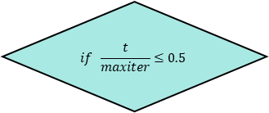
Start
Initialize the ESC parameters
Initialize the population
$$if \frac{t}{maxiter}≤0.5$$
While t<maxiter
return the best solution
Yes
Sorting the fitness of the population in acsending order
t=t+1
end
No
Divide the population into calm crowd,herding crowd and panic crowd with Eq. (3) , Eq. (4) and Eq. (5)
All population update thier position by Eq. (10)
Calm crowd update their position by Eq. (6)
Herding crowd update their position by Eq. (7)
Panic crowd w update their position by Eq. (8)
All population update thier position by Eq. (9)

